Slide 1
A Deep Convolution Neural Network Model for Vehicle Recognition
Guided by Assistant Professor Mrs.M. BLESSY QUEEN MARY
Submitted by
CHANDRALEKHA S(1418107)
RUCKSHANA S(1418138)
SUBHASHRI J(1418147)
SWATHI S(1418148)

Slide 2
OBJECTIVE
Vehicle recognition has become an important application in intelligent traffic monitoring and management.
A deep convolution neural network which is no less than nine layers.
A vehicle data set is employed which is collected from multiple perspectives and the deep learning framework is used to verify the proposed algorithm.

Slide 3
PROBLEM STATEMENT
Traditional algorithms have some flaws, such as low recognition efficiency, low accuracy of recognition efficiency.
After deep learning proposed, both the recognition accuracy and efficiency have a greatly improve.

Slide 4
LITERATURE SURVEY I
Vehicle detection in aerial images based on region convolutional neural networks and hard negative example mining
This paper has:
An HRPN to generate vehicle like regions, which combines hierarchiacal feature maps for small object detection which improves classification accuracy by hard negative example mining
The performance could be further improved by enhancing the resolution of the hyper feature map using deep convolution layers to improve the performance.

Slide 5
INTRODUCTION
A Deep convolutional Neural Network (DCNN) is comprised of one or more convolutional layers and then followed by one or more fully connected layers.
The DCNN is designed to take advantage of the 2D structure of an input image (or speech signal).
This is achieved with local connections and tied weights followed by some form of pooling which results in translation invariant features. Another benefit of CNNs is that they are easier to train and have many fewer parameters than fully connected networks with the same number of hidden units

Slide 6
EXISTING SYSTEM
Vehicle detection in aerial images based on region convolutional neural networks and hard negative example mining
Automated vehicle detection and classification with probabilistic neural network.

Slide 7
CHALLENGES
Poor performance for locating small sized vehicles.
Low accuracy.
Can’t distinguish vehicles and complex background.
Low resolution for large sized images.

Slide 8
PROPOSED SYSTEM
A Deep convolutional neural network has less than nine layers.
ReLU layer(Rectified Linear Units) or Activation layer
Pooling layer
Dropout layer
Network in network layer.

Slide 9
ADVANTAGES
Edge detection
Most time-consuming parts of machine learning practice.
Adapted to new problems easily

Slide 10
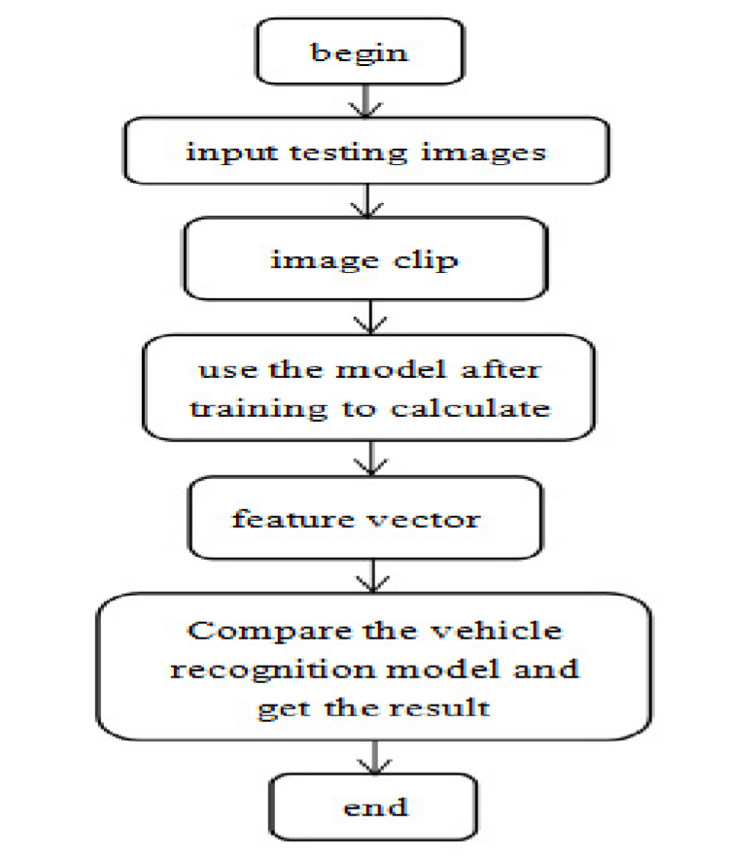
FLOW DIAGRAM

Slide 11
THANK YOU

